Slide 1

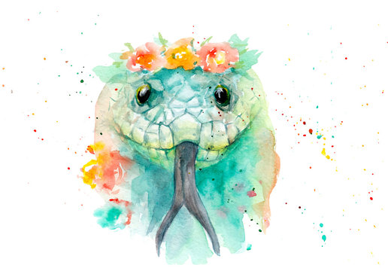
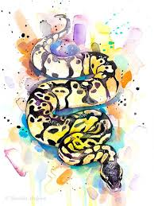
Snakes!
The guide to snakes!
By: Zoe Pretzer and Helena , my Girl Scout Bronze Award Project

Slide 2
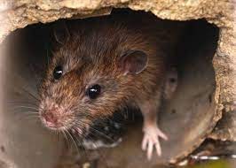
How are snakes helpful?
You are probably wondering, “How do snakes help us,” or “How in the world are they helpful when they bite us?” These are good questions! Snakes help us in many different ways. You know those pesky overpopulated rodents in your house including, mice, rats, etc? Snakes eat rodents that destroy, cause illnesses, and do no good in our homes!
Photo of a rat

Slide 3
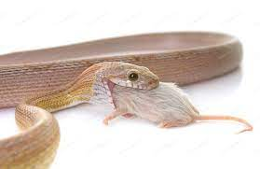
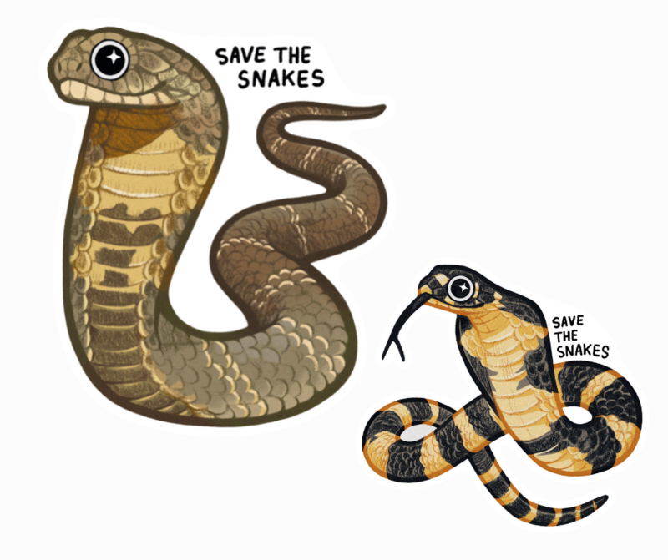
What are threats to snakes? And how can we make a difference?
Many snakes are killed by humans for no good reasoning. Snakes are often feared and scary, but in reality they are very helpful. Many people even have them as pets! Snakes are more afraid of us than we are of them, remember that. Many snakes habitats are destroyed, snakes are hunted down and killed, and even fearing snakes is a threat to them! What we can do is spread the word! Tell friends, family, people, everyone how important snakes are. They help us so we should help them as well.
Corn snake eating a mouse
Save the Snakes!

Slide 4
Tennessee's Non-Venomous Snakes
I had a blast learning about all of the different snakes in Tennessee, so I’m sure you will too!! :)

Slide 5
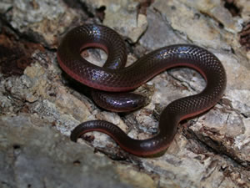
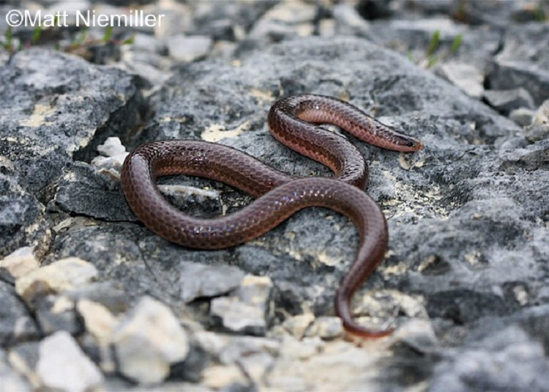
Wormsnake
About Wormsnakes:
Wormsnakes are small for snakes. They grow up to 13 inches long. (These snakes look like Worms) They are brown snakes and have the colors of the belly extend to the sides. Wormsnakes are found in deciduous forests throughout the U.S. These snakes can be found in rotting logs, under rocks, found in soil, or under piles of leaves.
Habitat: Wormsnakes are among the snake species that typically live underground. Worm snakes are not usually found above ground. Wormsnakes eat earthworms, Wormsnakes are prey to birds, other snakes, and mammals. Female Wormsnakes lay up to 12 eggs in the early summer.
Wormsnake!

Slide 6
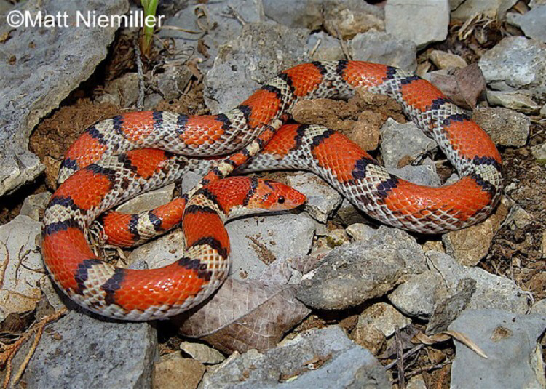
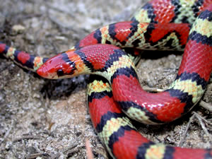
Scarletsnake
About Scarletsnakes:
Scarletsnakes have red, black, plus yellow or white alternating patterns on their bodies. These snakes are pretty small, they grow up to 20 inches long.
Habitat:
Scarlet snakes like dry sandy forests and spend most of their entire lives underground. Many Scarletsnakes are spotted in pine forests and sandhill scrub habitats. These habitats are easy for burrowing. Scarletsnakes like to hide underneath logs, rocks, or debris including trash, wood planks, and other leftover manmade materials.
Scarletsnake!

Slide 7
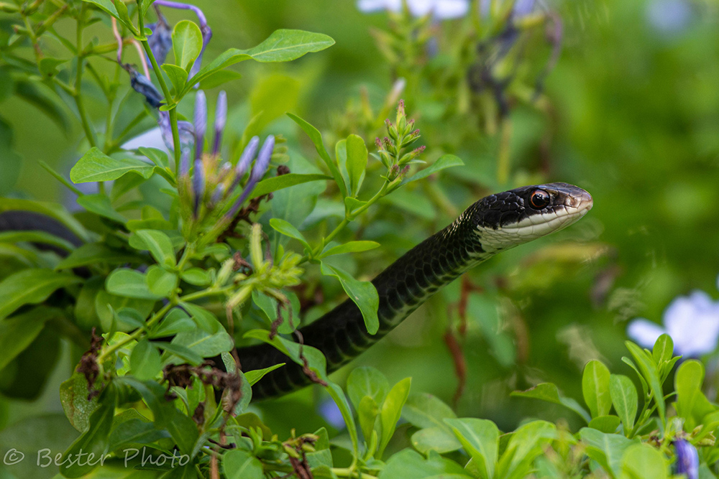
North American Racer
About the North American Racer:
Most fully grown North American Racers grow up to be 20-56 inches long. Adults colouring is black and or bluish with white markings decorating the chin and the throat. Young North American Racers are gray with red and brown markings on their back, and behind the head.
Habitat:
North American Racers live in habitats including, pine flatwoods, prairies, scrub, cypress strands, melaleuca forests, limestone rocks, etc. North American Racers are found in suburban neighborhoods and areas.
North American Racer

Slide 8
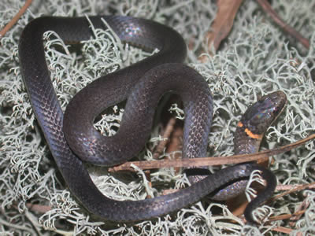
Ring-necked Snake
About Ring-necked Snakes
These small snakes grow to be 10-15 inches. Around their back they have yellowish or orange coloration. Ringnecks have a ring pattern around their necks. Females are slightly larger than the males and have shorter tails.
Habitat:
Ring-necked snakes prefer to hide under rocks, debris, logs, and other hiding places. These snakes live where floods could happen, wet forests, and the edges of wetlands. Females lay 2-7 eggs in the early summertime.
Ring-necked Snake

Slide 9
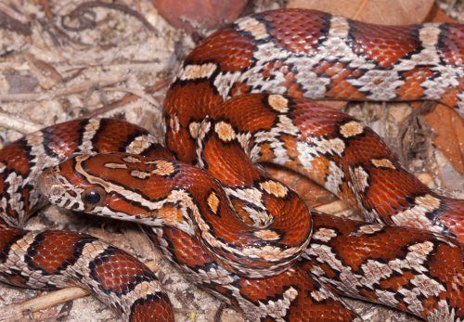
Red Cornsnake
About Red CornSnakes
A majority of the adult snakes length from 30-48 inches. Their coloring is a orange/brown color, orange outlined by black, or have brown dots. The Red Cornsnake’s juvenile are very similar in coloration but are more brown. The Red Cornsnake are not harmful to people but will bite in self-defense.
.
Habitat:
You will most likely find Red Corn Snakes in pinelands, hardwood forests, swamps, and farming fields.
Red Corn Snake!

Slide 10
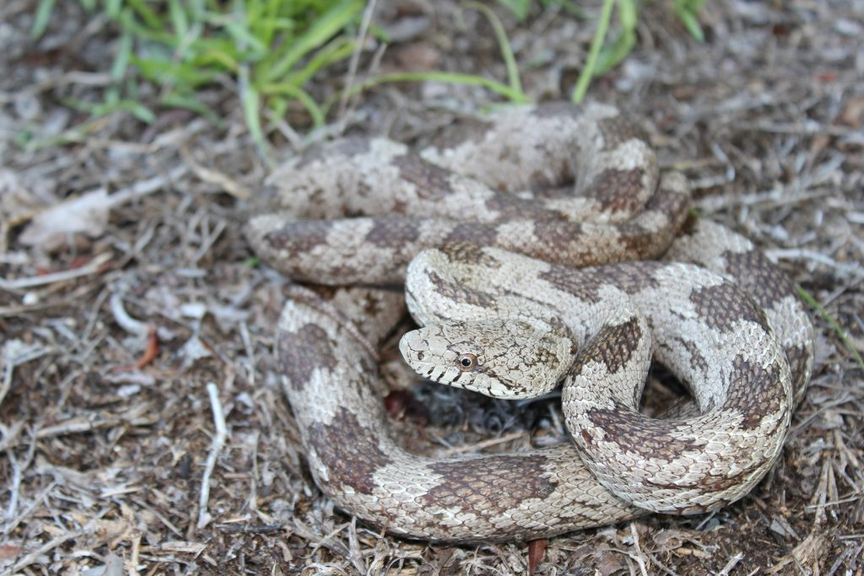
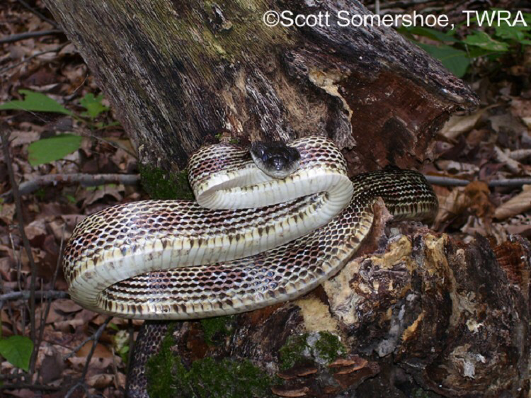
Gray Rat Snake
About Gray RatSnakes:
A majority of the Gray Rat Snakes grow to be about 42-72 inches long. The Adult Gray Rat Snakes are a light grey with dark grey splotches throughout the body. The coloration of this snake’s belly is a sandy-grey color with some dark grey coloring. Juveniles have very similar coloration compared to adults.
Habitat:
You will most likely find these snakes in pinelands,
Hardwood hammocks, cypress strands (on the ground), swampy
areas, marshes, prairies , farming fields, and old houses.
Gray Rat Snakes

Slide 11
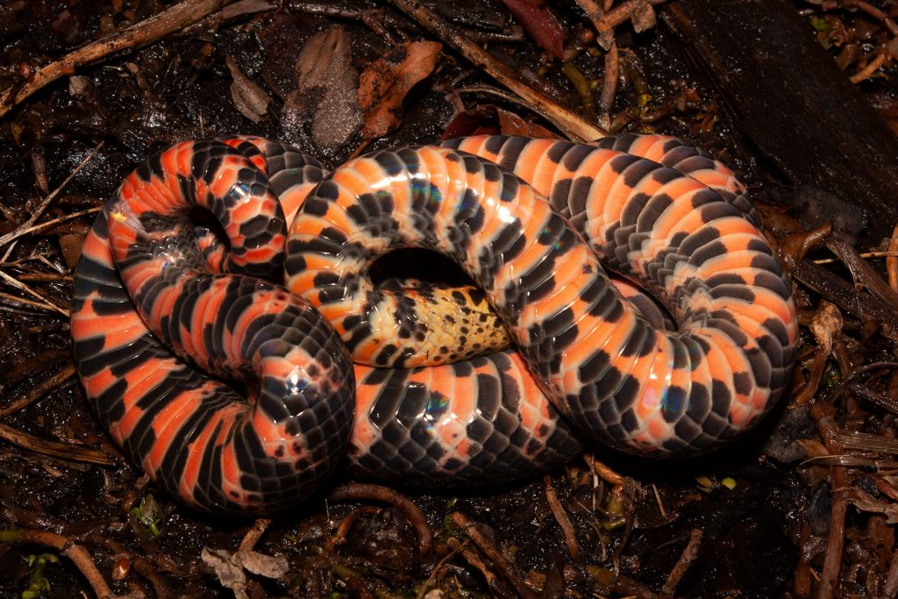
Red Bellied Mud Snakes
About Ring-necked Snakes
Most Red Bellied Mud Snakes range in length from 40-54 inches. The body is mostly a glossy black color, and shiny blue in sunlight. They have red/pink bars that stretch throughout the body. (53 or more bars.) These bars, pink/red and black alternate. Under the neck is a yellowish coloring. Juveniles have very similar coloring compared to the adult snakes.
Habitat:
These snakes can be found in calm freshwater, for example: (cypress swamps), canals, marshes, rivers, and lakes. The Red Bellied Mud Snake is primarily found in aquatic habitats. They like waters with good food source and muddy bottoms. These snakes will also find home in black waters and tidal creeks.
Red Bellied <<<Mud Snake

Slide 12
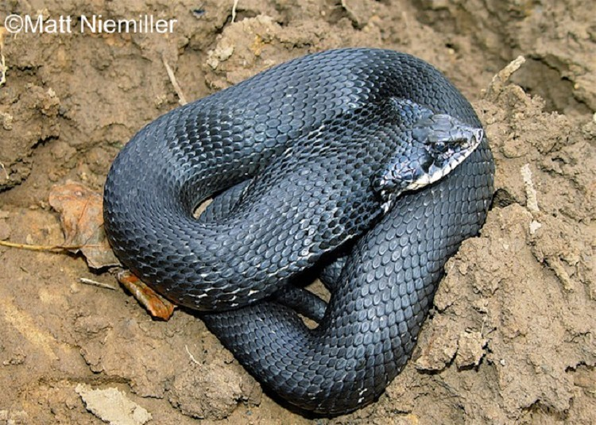
Eastern Hog-Nosed Snake
About Eastern Hog-Nosed Snakes:
This snake is usually 20-33 inches long. The snout is the easiest way to recognise the Eastern Hog Nose. The color of the snake can vary: colors can be yellow, orange, gray, brown, black+brown, or a black rectangular pattern that runs down the back. The coloration of they belly is gray or yellow, and a tad bit of green. The females weigh more and are longer than the males.
Habitat:
The Eastern Hog-Nosed Snake is fond of habitats that include: forested areas, sandy soils,
Agricultural fields, and the coastal areas.
.
Eastern Hog-Nosed Snake

Slide 13
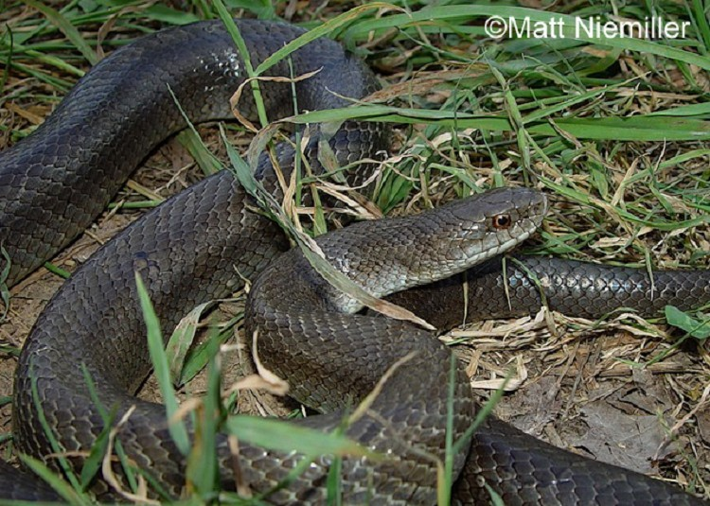
Yellow Bellied Kingsnake
About Ring-necked Snakes:
This snake is 30-42 inches long. They have glimmery and smooth scales along their bodies.
Mole Kingsnake: light brown, red with red/brown blobs with black on the outline. Lives in Eastern Part of State.
Prairie Kingsnakes: tan/gray, with brown and red blobs outlined by black. Lives in Northern Part of State.
Habitat:
Prefers to live in forests, farming areas, and suburban environments.
Yellow Bellied Kngsnake

Slide 14
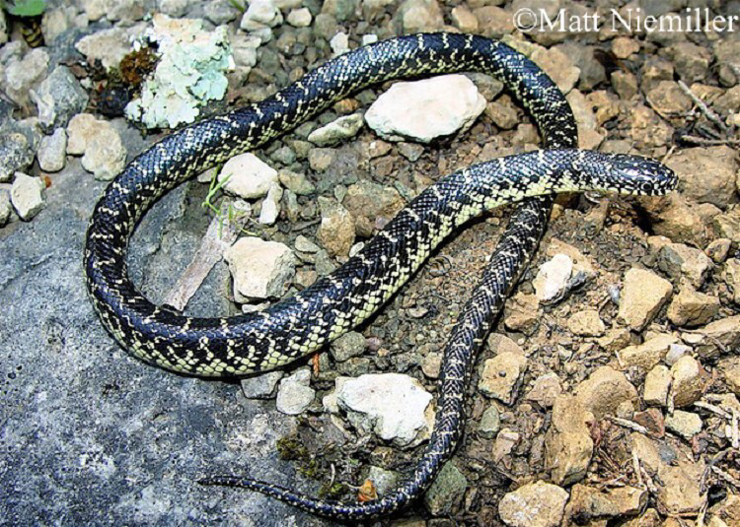
Common King Snake
About Common Kingsnake:
The common kingsnake has a shiny black color. They have yellow and or white speckled spots around their body. They also have yellow bands across their bodies. The pattern almost looks like a chain.
Habitat:
King snakes live in a lot of places! Including forests, fields, shrubby areas, forest edges, urban areas, and edges of wetlands. Common Kingsnakes have a preference streambanks and wetlands, but are also seen under wood or debris piles, climbing in barns or on stonewalls, and sunning in clearings or on hillsides.
Yellow Bellied Kngsnake

Slide 15
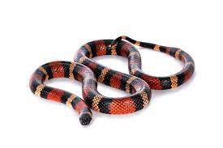
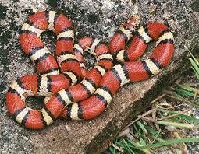
Milksnake
About Milksnakes:
The Milksnake has very similar coloration to the venomous Coral Snake: (CORAL SNAKES DO NOT LIVE IN TENNESSEE)
The coloration is a very colorful orange and white with black outlines.
Habitat:
Milksnakes are found in many different habitats, but generally prefer pine or hardwood forests with rock outcroppings. They also live under rocks or logs in other habitats including fields, savannahs, agricultural areas , suburban, wetlands, and forest edges.

Slide 16
Venomous Tennessee Snakes
They aren’t as scary as they seem!! :p

Slide 17
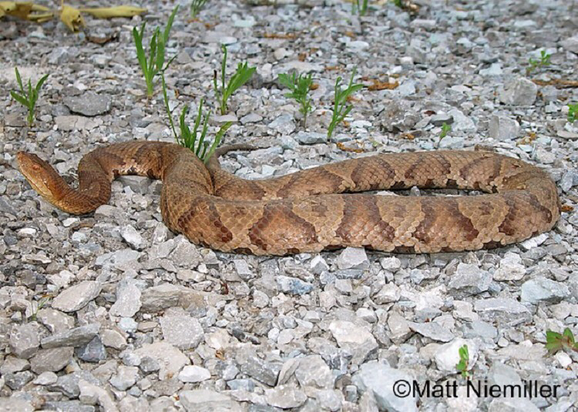
Copperhead
About Copperheads: The copperhead is 24-36 inches in length. They have a large triangle
shaped head. The coloration of the head is reddish. They have vertical pupils on their eyes.
Habitat:
Living in forested habitats, the cottonmouth avoids open areas like pastures and agricultural fields. The Copperhead is usually found under rocks and wooded hillsides.

Slide 18
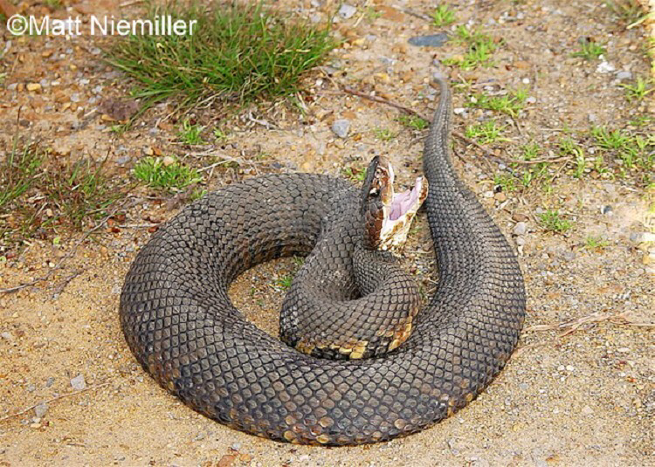
Cotton Mouth
About Cotton Mouth Snakes:
Cottonmouths get their name from the color of the inside of their mouths!
Habitat: Cottonmouths are found in swamps, wetlands, sloughs, and drainage ditches. They can also be found near rivers.
Cotton Mouth Snake

Slide 19
Timber Rattlesnake
About Timber Rattlesnakes:
Habitat:
They are found in heavily wooded forests with rocky hillsides. Also found in mountains and swamps.

Slide 20
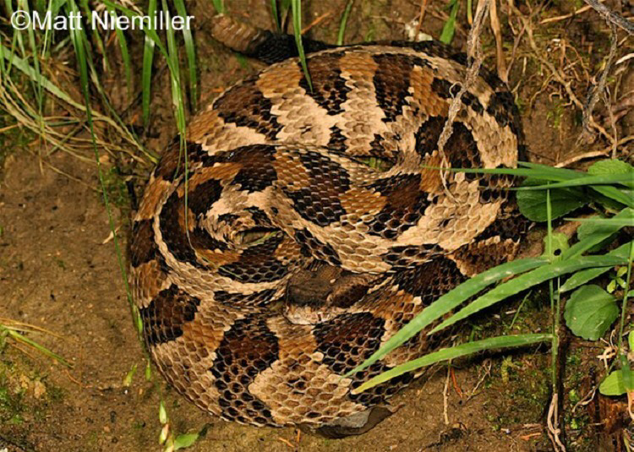
Timber rattlesnake
They are found in heavily wooded forests with rocky hillsides. Also found in mountains and swamps.

Slide 21
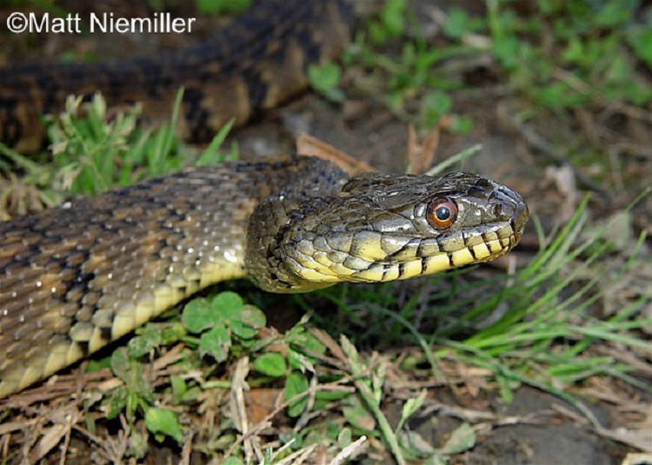
Diamond back watersnake
Found aquatic habitats, but usually in oxbow lakes, rivers, cypress swamps, marshes, and sloughs.

Slide 22
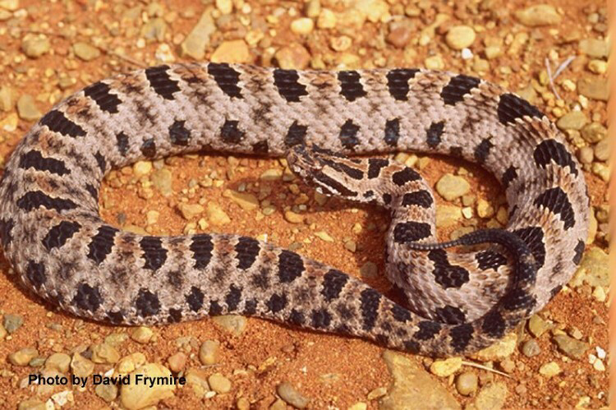
Pygmy rattlesnakes
Most Pygmy rattlesnakes are found near water. They can be found wet fields,rocky uplands, and pine woods.

Slide 23
Extras!
Sources, Sites YOU can visit, image links, fun facts, and more!!

Slide 24

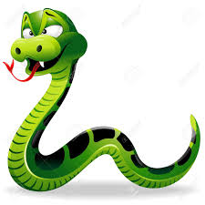
10 Fun Facts!
Sure, venomous snakes can be scary at times. Venomous snakes are underrated. People are like, “Venomous snakes are the worst!!” They actually aren’t. Snakes will only bite if they feel like they are being harmed. Only 50 out of 1000 people every year die from venomous snake bites. If you get a snake bite, go directly to the hospital if your unsure which snake it was.
Some snake venom is used for experiments, science, treatments, medicines, etc
Snakes do not have eyelids, unlike us
The process snakes do to shed their skin takes days
Python reticulates are the longest snakes in the world
We have sense of smell with our nose, but snakes use their tongues for their sense of smell
Snakes don’t have the ability to bite their food so they swallow whole
Some species of Sea Snakes breathe out of their skin, which allows them to breathe underwater longer
Pythons kill their prey by wrapping their long bodies around it and then suffocating the prey.
Around the world there are over 3000 species of snakes!

Slide 25
Image Links
https://www.istockphoto.com/photos/rat-hole <<< Rat in a hole image
https://envato-shoebox-0.imgix.net/d41c/a6e9-f32c-4b53-b72f-5b0291b3cdaa/170223-172814.jpg?auto=compress%2Cformat&fit=max&mark=https%3A%2F%2Felements-assets.envato.com%2Fstatic%2Fwatermark2.png&markalign=center%2Cmiddle&markalpha=18&w=1600&s=3698edbf32e9c6a8de2468df410fa56e <<< Image of a corn snake eating a mouse
https://d2j6dbq0eux0bg.cloudfront.net/images/12488122/2494799014.jpg Image of “Save the Snakes”
https://srelherp.uga.edu/snakes/pics/cemcoc3.jpg <<< Scarletsnake
https://srelherp.uga.edu/snakes/pics/caramo4.jpg <<Wormsnake
https://www.floridamuseum.ufl.edu/wp-content/uploads/sites/116/2020/08/DSC_5358_sm.jpg <<< North American Racer
https://srelherp.uga.edu/snakes/pics/diapun1.jpg <<< Ring-necked Snake

Slide 26
More Image Links
https://www.floridamuseum.ufl.edu/wp-content/uploads/sites/116/2020/08/photo_26-Eastern-cornsnake-SQ-1-500x347.jpg <<< Red Corn Snake
https://www.floridamuseum.ufl.edu/wp-content/uploads/sites/116/2020/10/IMG_5164-1024x683.jpg <<< Gray Rat Snake
https://www.floridamuseum.ufl.edu/wp-content/uploads/sites/116/2020/10/photo_19-1024x683.jpg <<< Red Bellied Mud Snake
https://www.tn.gov/content/tn/twra/wildlife/reptiles/snakes/eastern-hog-nosed-snake/jcr%3acontent/contentFullWidth/tn_panel/content/tn_columnctrl/column_parsys1/tn_image.img.jpg/1580852470456.jpg <<< Eastern Hog-Nosed Snake
https://www.tn.gov/content/tn/twra/wildlife/reptiles/snakes/yellow-bellied-kingsnake/jcr%3acontent/contentFullWidth/tn_panel/content/tn_columnctrl/column_parsys0/tn_image.img.jpg/1585159107248.jpg <<< Yellow Bellied Kingsnake

Slide 27
Sources
https://www.pbs.org/wnet/nature/the-reptiles-snakes-saving-snakes/2911/ <<< More About Snakes
https://srelherp.uga.edu/snakes/caramo.htm <<< Worm Snakes
https://srelherp.uga.edu/snakes/cemcoc.htm <<< Scarletsnake
https://srelherp.uga.edu/snakes/diapun.htm <<< Ring-necked snakes
https://www.sciencekids.co.nz/sciencefacts/animals/snake.html <<< Fun fact website!
https://www.nationalgeographic.com/animals/reptiles/facts/snakes-1 <<< About snakes
https://www.floridamuseum.ufl.edu/florida-snake-id/snake/red-cornsnake/ <<< About Red Cornsnakes

Slide 28
More sources!
www.floridamuseum.ufl.edu/florida-snake-id/snake/gray-ratsnake/ <<< Gray Rat Snakes
www.floridamuseum.ufl.edu/florida-snake-id/snake/red-bellied-mud-snake/ <<< Red Bellied Mud Snakes
ps://www.tn.gov/twra/wildlife/reptiles/snakes/eastern-hog-nosed-snake.html <<< Eastern Hog-Nosed Snakes
https://www.tn.gov/twra/wildlife/reptiles/snakes.html <<< All Snakes Of Tennessee
https://www.tn.gov/twra/wildlife/reptiles/snakes/yellow-bellied-kingsnake.html <<< Yellow Bellied Kingsnake
https://www.tn.gov/twra/wildlife/reptiles/snakes/milksnake.html <<< Milksnake
https://www.tn.gov/twra/wildlife/reptiles/snakes/copperhead.html <<< Copperhead
More Sites
https://www.tn.gov/twra/wildlife/reptiles/snakes.html
http://www.snakestn.com
http://tennsnakes.org/

Slide 29

Thankssssss
I learned a lot about snakes while working on my bronze award project. (this slideshow) I hope you learned a few cool things about awesome snakes, and after this I hope you like snakes a little more.

Slide 30
Where do our Tennessee snakes live?

Slide 31
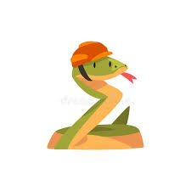

Funny Snake Joke!
What do you call a snake that builds things?
Click for Answer
A Boa Constructor!!!
Answer Here ->
More Snake Jokes! ->

