Slide 1
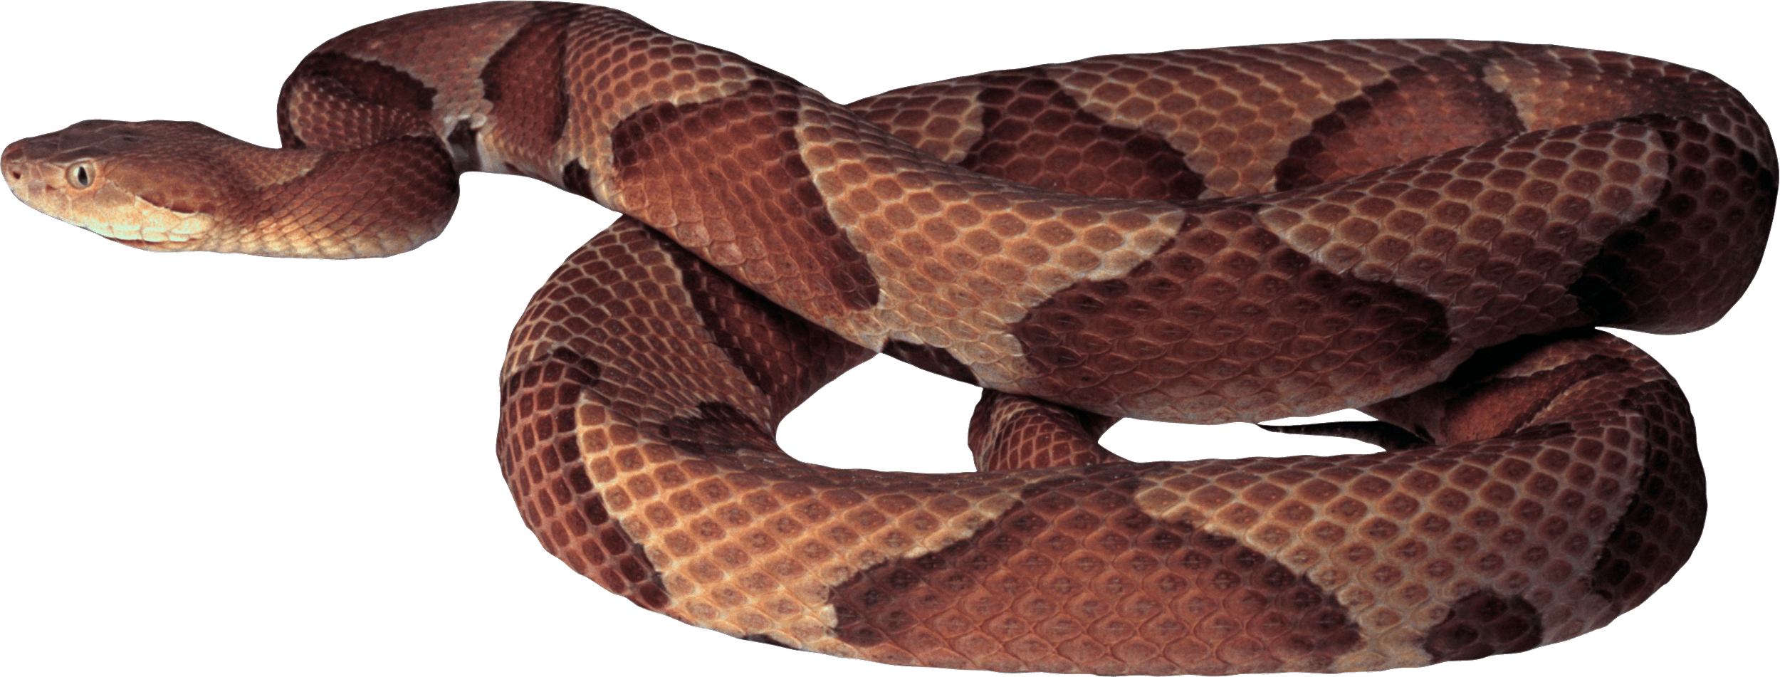
Snake Encounters
This Photo by Unknown author is licensed under CC BY-NC.
What to do when you're face to face with a snake in the wild, your yard, or your house?

Slide 2
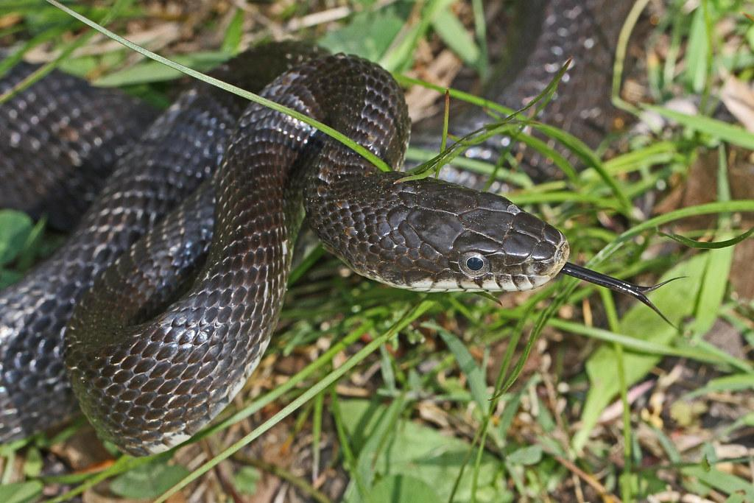
Snake Encounter in the Wild
Stop
Back away slowly. Snakes can strike up to one-half their body length.
Do not try to kill
Walk away
https://www.theoutbound.com/imogene-cancellare/snakes-on-a-trail-5-tips-for-dealing-with-snakes-while-hiking
This Photo by Unknown author is licensed under CC BY-NC.

Slide 3
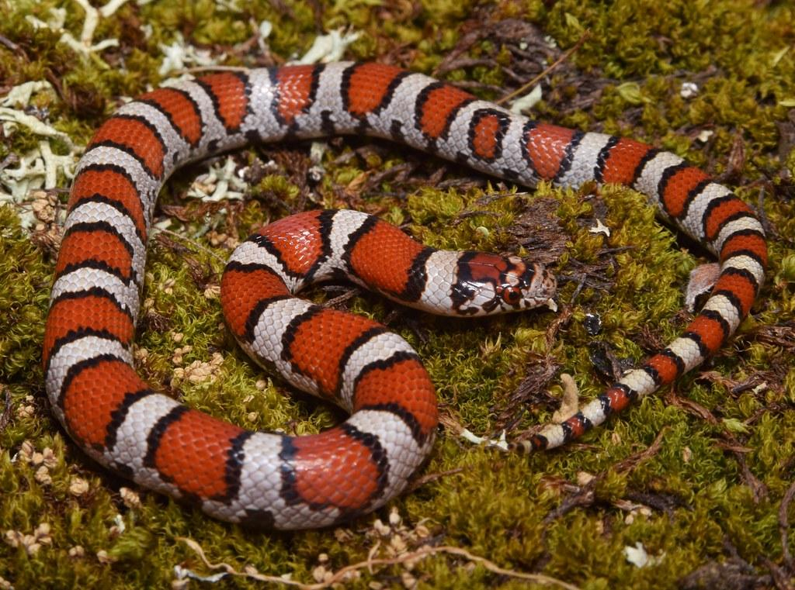
Snake Encounter in Your Yard
Stop
Back away slowly. Snakes can strike up to one-half of their body length.
Do not try to kill
Treat all unidentified snakes as venomous
If non-venomous, walk away.
If venomous, walk away, secure pets, tell everyone
CALL animal control
https://www.theoutbound.com/imogene-cancellare/snakes-on-a-trail-5-tips-for-dealing-with-snakes-while-hiking
This Photo by Unknown author is licensed under CC BY-ND.

Slide 4
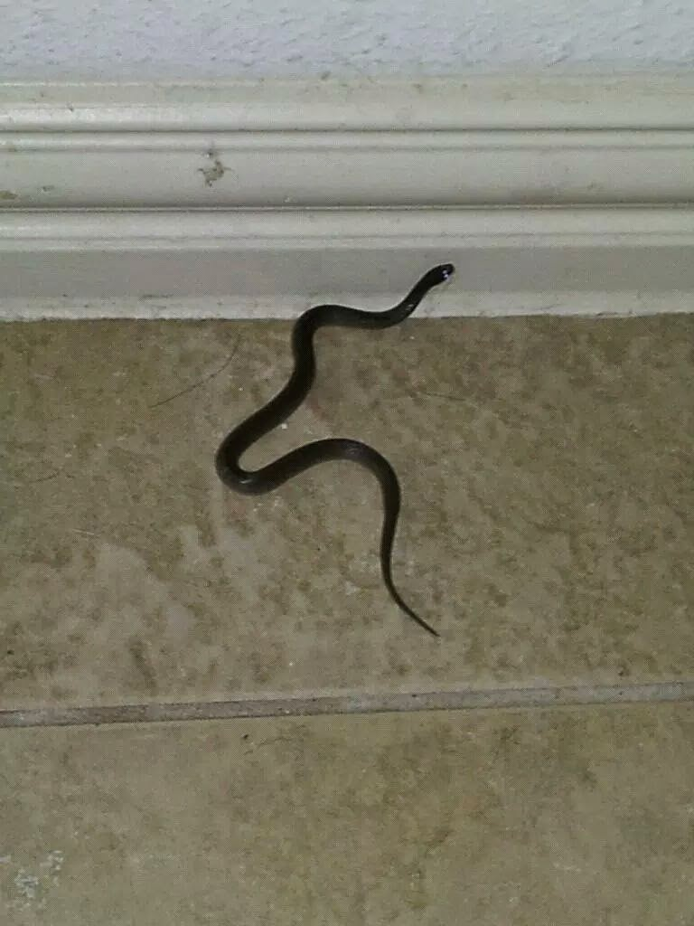
Snake Encounter in Your House
Stop
Back away slowly(Snakes can strike up to one-half of their body length)
Do not try to kill
Treat all unidentified snakes as venomous
If non-venomous, walk away, secure pets, tell everyone(Snakes eat rodents and insects)
If venomous, walk away, secure pets, tell everyone
Barricade/confine if possible
CALL animal control
https://www.wikihow.com/Deal-With-a-Snake-in-the-House
This Photo by Unknown author is licensed under CC BY-NC-ND.

Slide 5
What if You Get Bitten by a Snake?
Treat all snake bites as venomous
Safely, take a picture of the snake
Everyone, including the victim, stay calm and move as little as possible
Immediately seek medical attention(Call 911)
Keep bite below the level of the heart(don’t move erratically), clean the wound, and bandage it
Do NOT try to catch or kill snake
Do NOT apply tourniquet or try to remove venom
https://www.cdc.gov/disasters/snakebite.html#:~:text=Seek%20medical%20attention%20as%20soon,the%20level%20of%20the%20heart.

